Slide 1
Anatomy of a Check
An overview

Slide 2
What is a Check?
A negotiable instrument used in place of cash
A written order to a bank to pay a stated amount from an owner’s account
Can be written to an individual or an organization (i.e., company, retailer, etc.)
Funds are drawn from the owner’s account on deposit at the financial institution

Slide 3
The Basics of a Checking Account
To write checks you need a checking account
A checking account allows easy access to your funds
You can access your money by writing a check or use an ATM card
The checking account is insured by the Federal Depositor Insurance Corporation (FDIC)

Slide 4
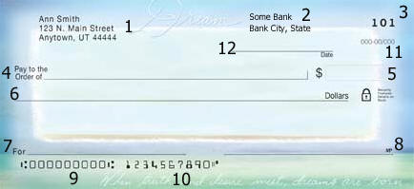
Sample Check

Slide 5
Parts of a Check
1. Drawer / Account Holder:
    The person or entity making the check

Slide 6
Parts of a Check
2. Bank Name:
The financial institution (bank or credit union) where the funds are held and the check can be presented for payment

Slide 7
Parts of a Check
3. Check Number:
  The check number is located in the upper right hand corner
  Each check is numbered sequentially

Slide 8
Parts of a Check
4. Payee:
  The name of person or company being paid

Slide 9
Parts of a Check
  5. Check Amount:
  The check amount written in figures
  (i.e., 500.00)

Slide 10
Parts of a Check
6. Check Amount:
  The check amount written in words
      (i.e., five hundred and 00/100)
  Note: The written words and figures should agree!!!

Slide 11
Parts of a Check
7. For / Memo Line:
This field may be left blank or used to enter other information such as an account number or Personal notations

Slide 12
Parts of a Check
8. Signature:
Account holder sign the check

Slide 13
Parts of a Check
9. Routing Number:
  Identifies the financial institution (i.e., city/state
  This is a 9-digit Magnetic Ink Character Recognition (MICR) code that routes the check to the issuing bank

Slide 14
Parts of a Check
10. Account Number:
  The holder’s account number is also (MICR)encoded

Slide 15
Parts of a Check
11. Fraction Code:
Identifies the routing for the check
Note: If the MICR line on the check is mutilated, the fraction code is used in its place

Slide 16
Parts of a Check
12. Date field:
  Date the check was issued

Slide 17
Checks are on the Decline
Due to increase usage of debit cards (i.e., point of sales, online banking, etc.)
However, they are still written and widely accepted as legal tender
###

